Slide 1
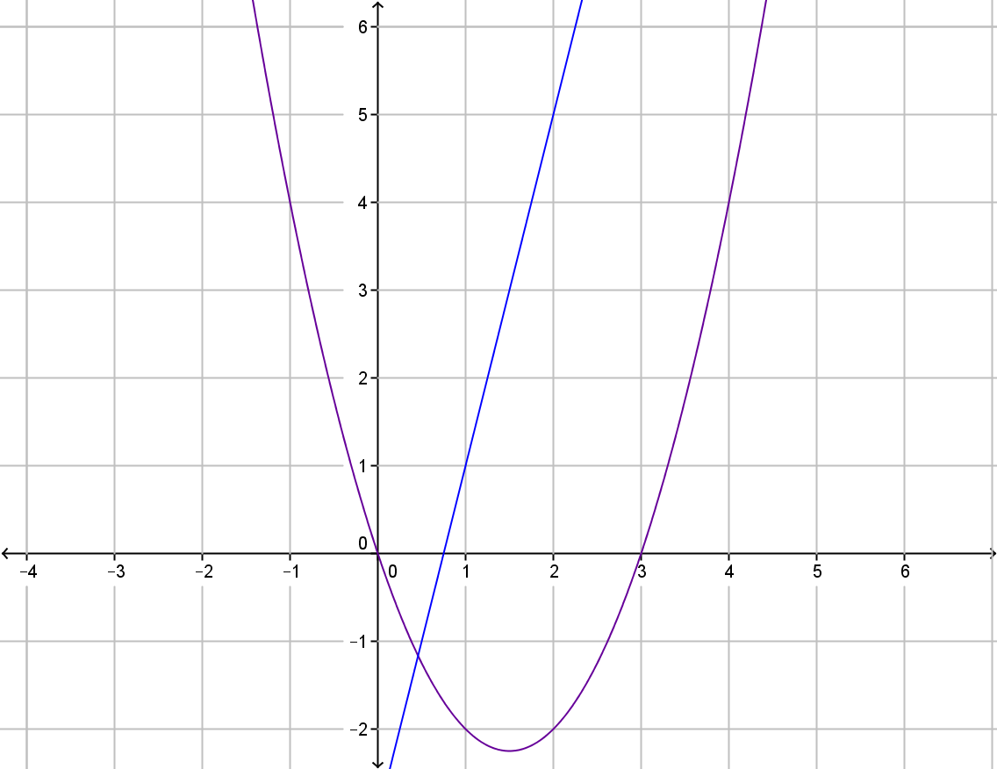
My Non-Linear Relationships Interactive Notebook
Name
Class
Term 4 Semester 2

Slide 2
Contents
Formula Page
Page
Date
Description
2
3

Slide 3
Tasks
24
7
30
Essential Question
Questions
Notes
Summary
6
7

Slide 4
24
7
30
Date
Properties of Quadratic Graphs
EQ – Describe the properties of a quadratic graph.
7

Slide 5
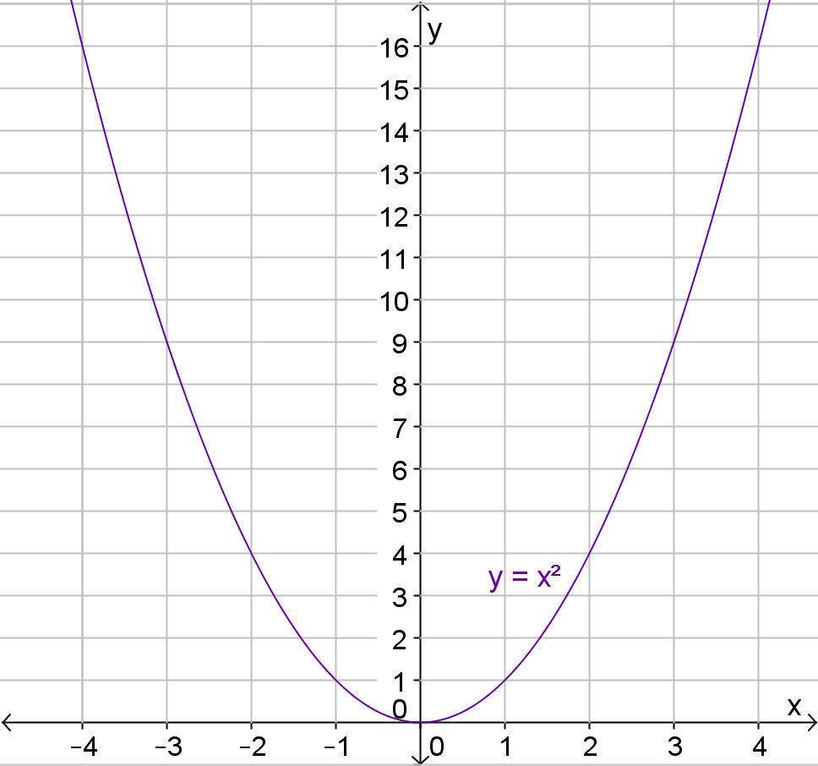
What can you tell me about this graph

Slide 6
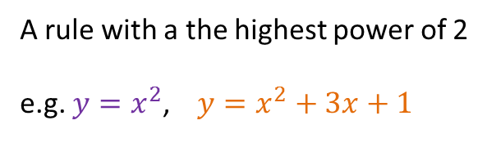
24
7
30
Date
Properties of Quadratic Graphs
EQ – Describe the properties of a quadratic graph.
A rule with a the highest power of 2
e.g. $y=x^{2}$,$y=x^{2}+3x+1$
7

Slide 7

24
7
30
Date
Properties of Quadratic Graphs
EQ – Describe the properties of a quadratic graph.
A rule with a the highest power of 2
e.g. $y=x^{2}$,$y=x^{2}+3x+1$
The equation is in the form $y=ax^{2}+bx+c$
7

Slide 8
24
7
30
Date
Properties of Quadratic Graphs
EQ – Describe the properties of a quadratic graph.
A rule with a the highest power of 2
e.g. $y=x^{2}$,$y=x^{2}+3x+1$
The equation is in the form $y=ax^{2}+bx+c$
The graph of a quadratic is called a parabola
7

Slide 9
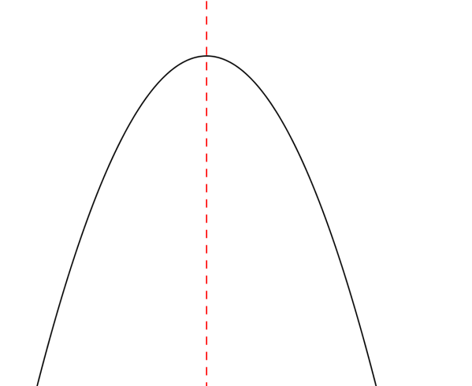
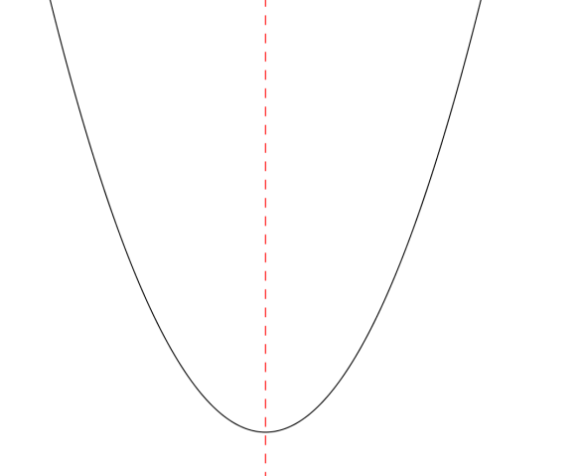
24
7
30
Date
Properties of Quadratic Graphs
EQ – Describe the properties of a quadratic graph.
The graph of a quadratic is called a parabola
Maximum
Minimum
Properties -
Line of symmetry
A maximum or minimum turning point
7

Slide 10
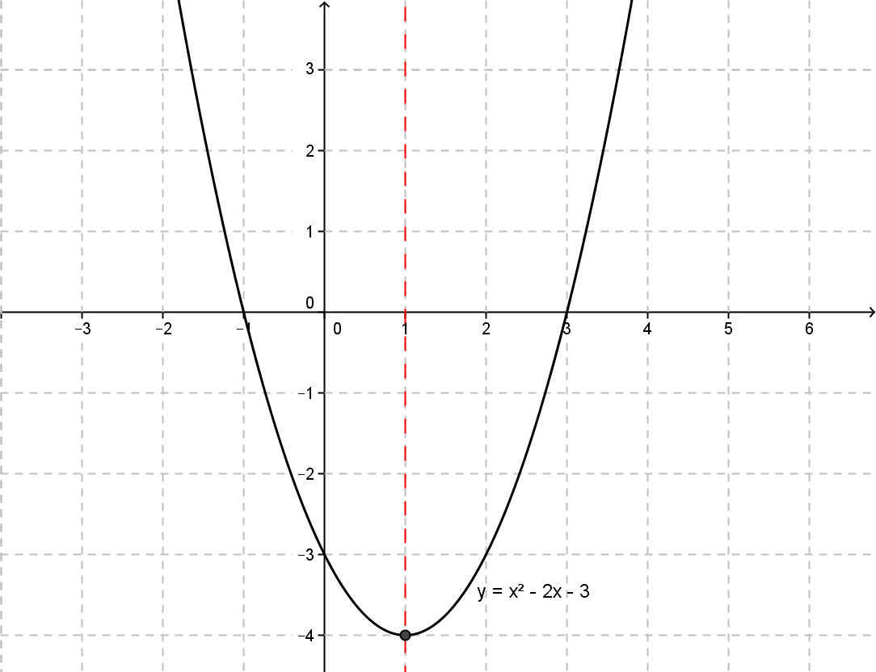


24
7
30
Date
Properties of Quadratic Graphs
EQ – Describe the properties of a quadratic graph.
$$x−intercepts$$
$y$-intercept
7

Slide 11
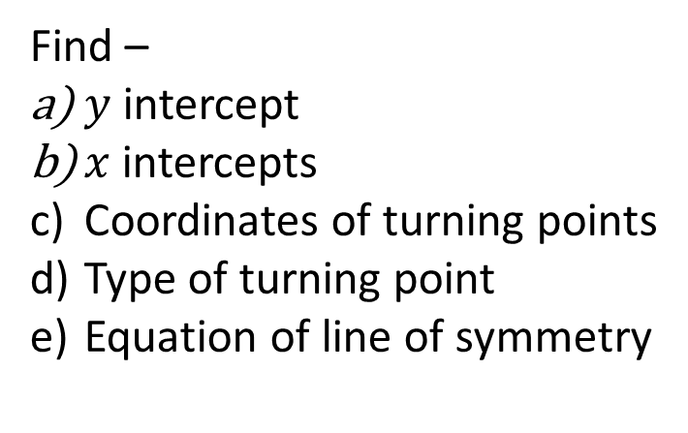
Task
Find –
$y$intercept
$x$ intercepts
Coordinates of turning points
Type of turning point
Equation of line of symmetry

Slide 12
Task
Find –
$y$intercept
$x$ intercepts
Coordinates of turning points
Type of turning point
Equation of line of symmetry
Page 594 question 3

Slide 14
Questions

Slide 15
Notes Review
24, 7 ,30
Date
Title
Essential question
Notes complete
Notes complete with colour and diagrams
Questions completed
Contents page filed in
Formula page filled in

Slide 16
Homework
Review your notes and write a summary answering the essential question.

